Slide 1

News popularity in Multiple social media platforms
Hemanth Reddy Musipatla

Slide 2


PREVIOUSLY ON PART - I
Starting of with analysis and prediction of news popularity prediction on multiple social media platforms to obtain best Regression Model.
From this analysis we can predict the future popularity of news article published online given the popularity of news already published.
We performed data cleaning on dataset. Some of the cleaning steps involved in deleting duplicate rows, outlier treatment (90th percentile quantile method) and dropping the rows with unpublished news.

Slide 3
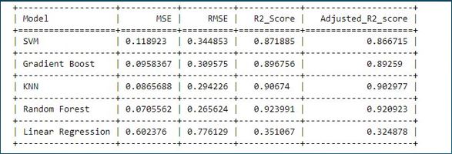
PREVIOUSLY ON PART - II
As part of cleaning, we are further used NLPTK to process text data.
We used “stopwords” package from NLPTK followed by “Tfidvectorizer” to convert text into features. We also used one hot encoding to convert categorical data into numerical data.
We trained several models like KNN, Linear regression, Gradient boosting, Random forest and compared with the Baseline model SVM.
Finally, we found that random forest as our best model in project part 2.

Slide 4

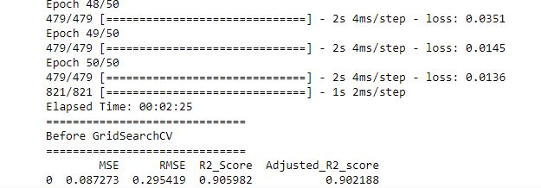
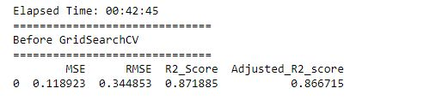
PERFORMING REGRESSION
DEEP LEARNING
SVM WITH NONLINEAR KERNEL

Slide 5
MODEL STRUCTURE SELECTION
DEEP LEARNING
SVM WITH NONLINEAR KERNEL

Slide 6
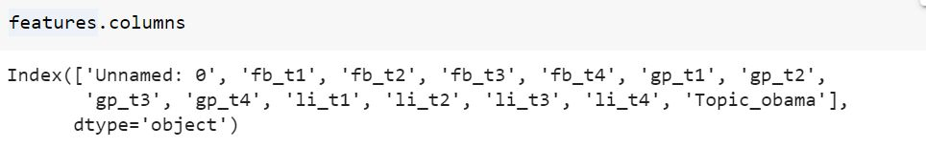
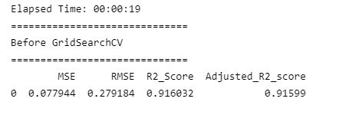
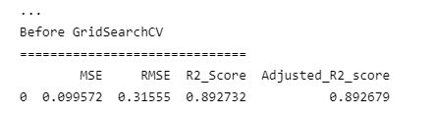
VARIABLE SELECTION
Since this a regression problem. Lasso is a suitable method for variable selection. It can select the attributes that have strong association with the output variable by minimizing the prediction error.
Random Forest and Deep Learning are the best models which we got from part - 2 and part – 3 respectively.
For Random Forest
For Deep Learning

Slide 7
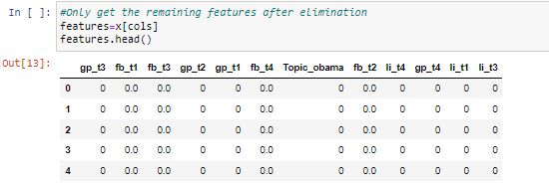
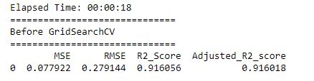
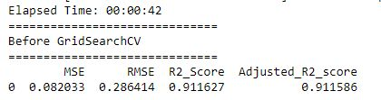
BI-DIRECTIONAL ELIMINATION
It is similar to forward selection, but when a new feature is added, it also evaluates the relevance of previously added features. If any previously picked characteristics are determined to be inconsequential, that feature is then simply eliminated by backward selection.As a result, it combines backward elimination with forward selection.
Parameters used : bidirection(data, target,SL_in=0.05,SL_out = 0.05)
Random Forest
Deep Learning

Slide 8
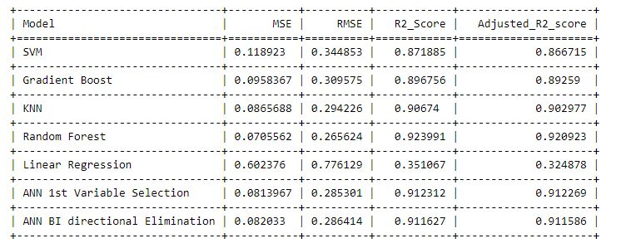
COMPARISION OF TEST RESULTS
Comparison of test results with previous single models of part - 2.

Slide 9
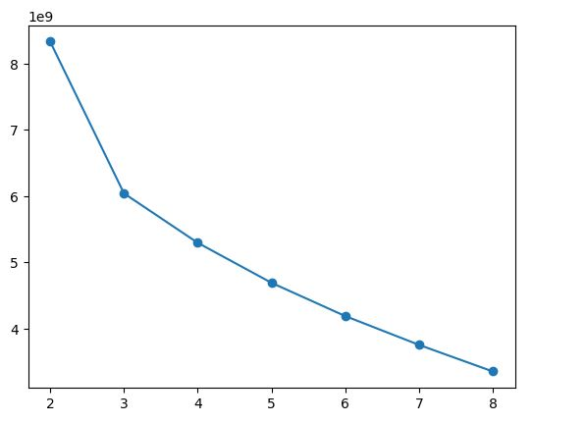
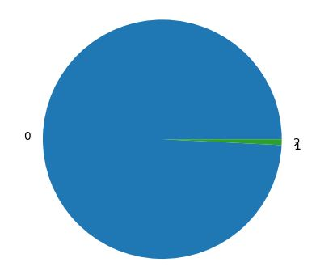
CLUSTERING
Using K means clustering to find the optimal number of clusters.
Within-cluster-sum-of-squares method(WCSS) have shown that k means with 3 clusters gives best results. so k=3 is used for clustering. 99.2% of the samples were clustered into cluster1, 0.7% in to cluster2 and 0.1% into cluster3.
km=KMeans(init=‘kmeans++',n_clusters=cluster,n_init=90,random_state=10).fit(data)
res.append(km.inertia_)
plt.plot(clusters,res,marker='o')

Slide 10
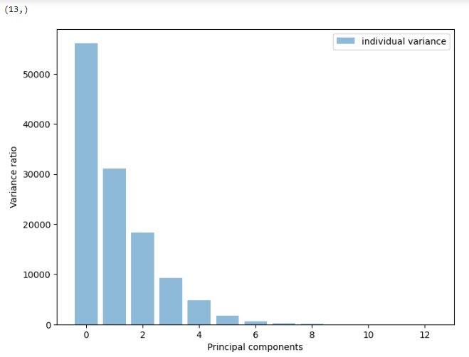
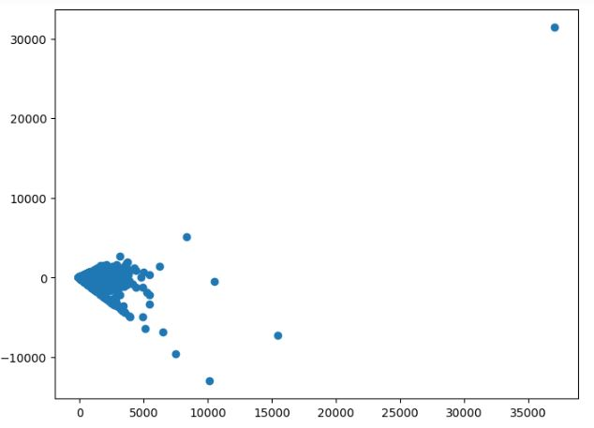
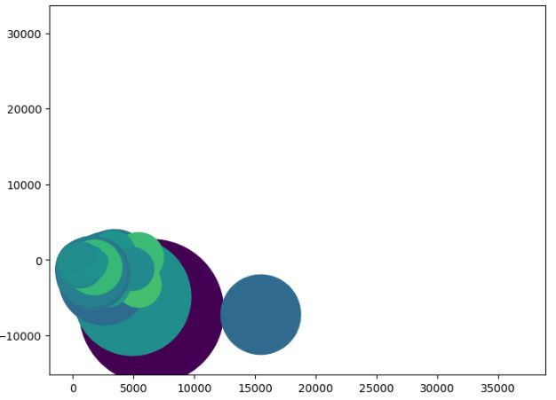
VISUALIZATION
On performing linear dimensionality reduction technique using PCA have given the following results.
Using bar plot to present number of principle components.
Visualizing the scatterplot with 5 and 2 principle components.

Slide 11
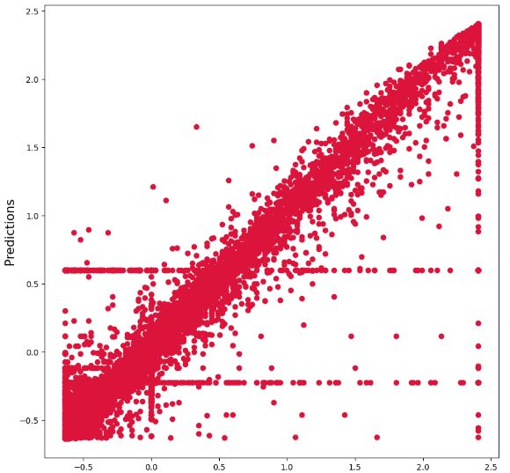
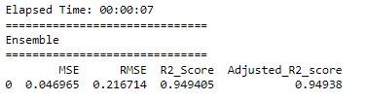
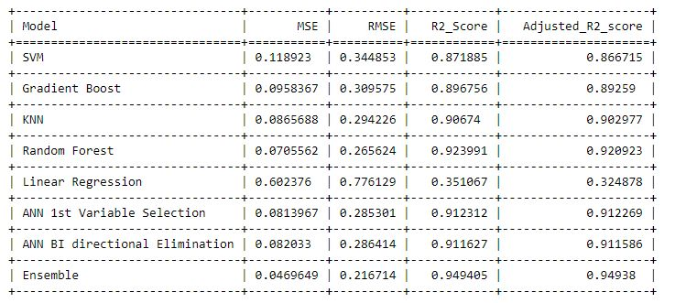
ENSEMBLE
After importing bagging regressor from sklearn.ensemble and DecisionTreeRegressor from sklearn.tree
Used Kfold modelselection by passing parameters of 10 (n_splits).
Passed base_estimator parameter as decisionTreeRegressor() and n_estimators with 20 trees.
Finally, we got R2_score of 94% which is best among all models.

